Slide 1
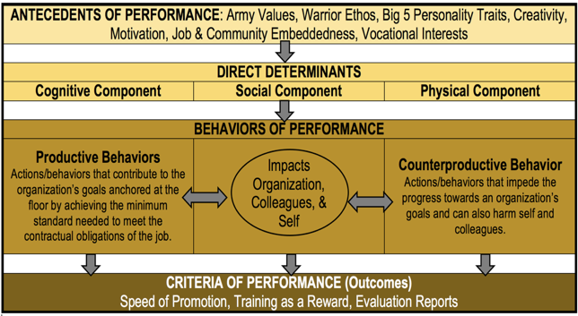
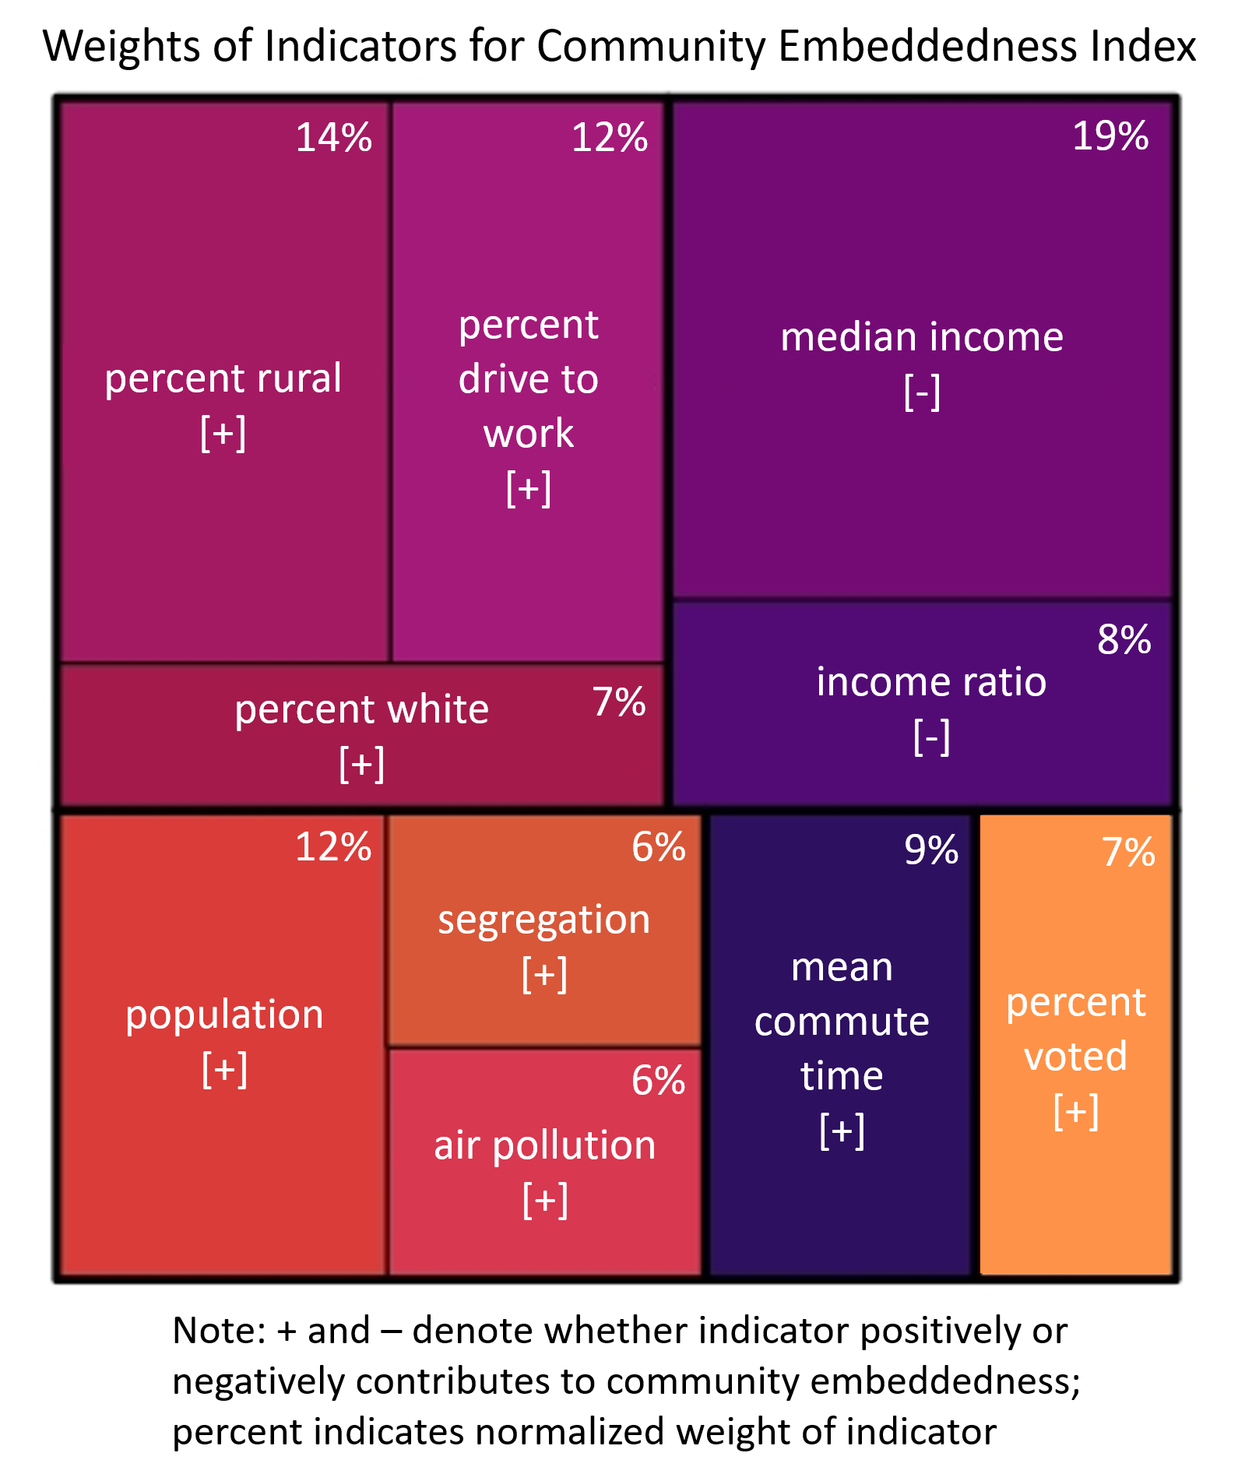
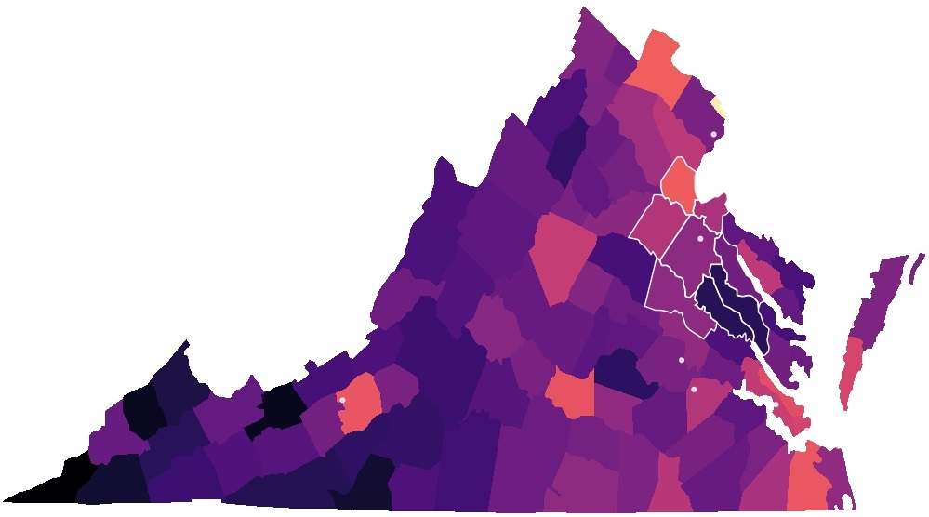
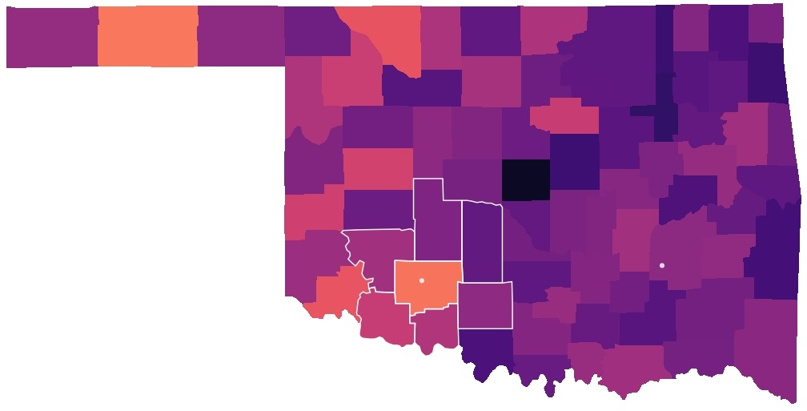
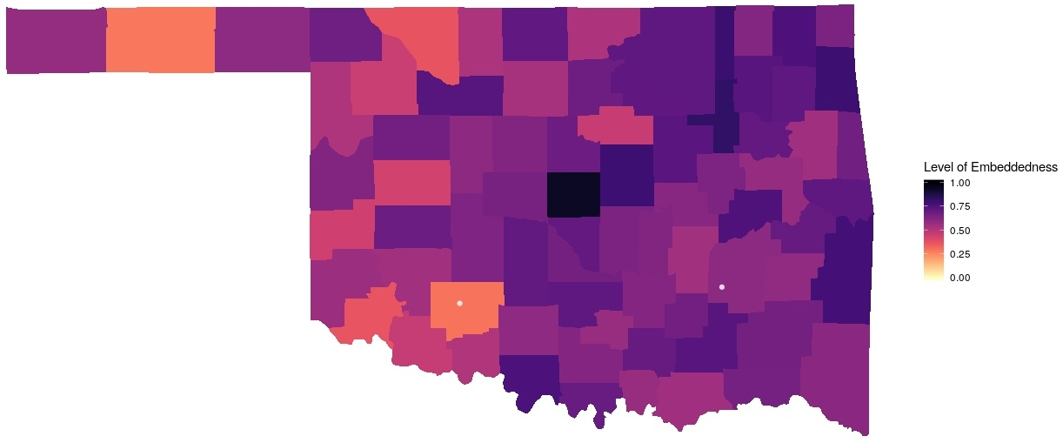


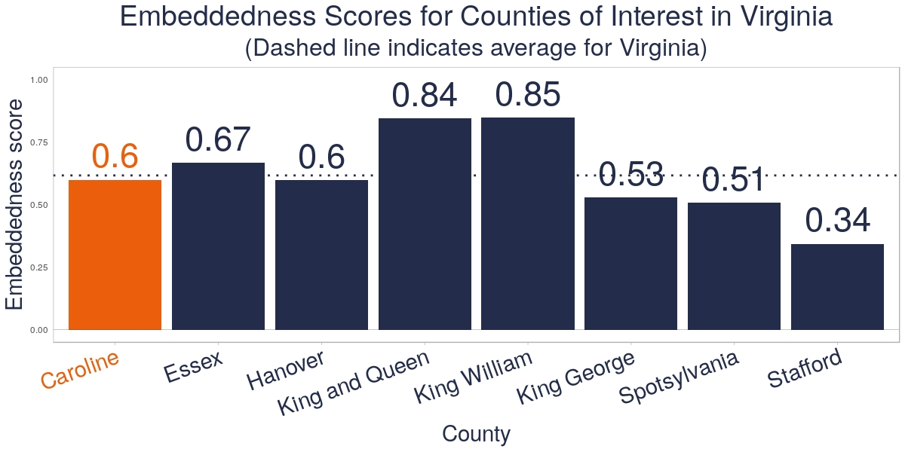
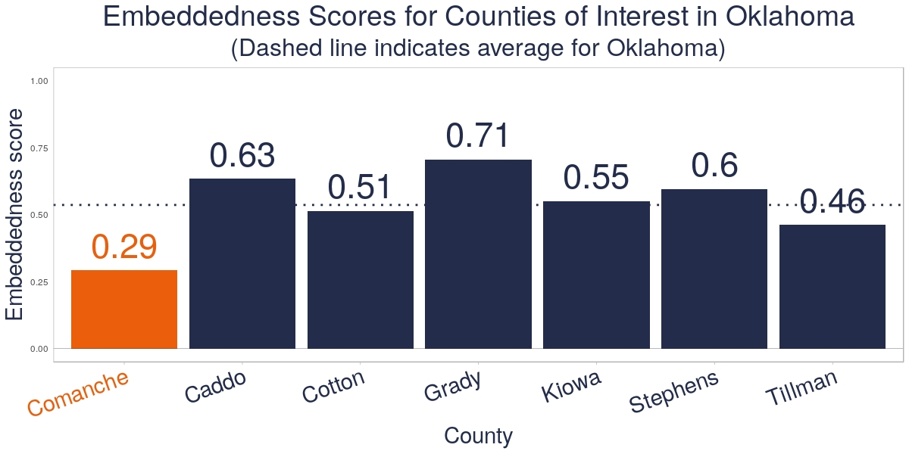

Measuring community embeddedness
near army installations: A feasibility study
DSPG Team: Jessica Keast (Smith College), Sean Pietrowicz (University Notre Dame), Allegra Pocinki (Rutgers University)
SDAD Team: Stephanie Shipp, Joel Thurston, Brandon Kramer, Vicki Lancaster, Josh Goldstein, Nathaniel Ratcliff
Sponsor: Kelly Ervin, U.S. Army Research Institute for Social and Behavioral Research
PROJECT DESCRIPTION
Data selection
Goal: Define and create composite indicators for measuring community embeddedness
The ARI-SDAD collaboration seeks to understand the relationship between the Soldier’s community and Soldier performance and behavior.
Research Questions:
What is community embeddedness, and what characteristics of a community promote embeddedness?
How does community embeddedness differ in counties with an Army post to surrounding counties?
Using the Social Determinants of Health literature, we used data from the American Community Survey, County Health Rankings,
Annie E. Casey Foundation Kids Count, Virginia Department of Elections, and Oklahoma State Election Board on:
Neighborhood and built environment
Health and home case
Economic stability
Education
Social and community context
COMMUNITY EMBEDDEDNESS Literature
creating the index
Community embeddedness is often studied in terms of job embeddedness, measured using surveys of employees [2-6]
Community embeddedness refers to social links made within an individual’s community, quality of community fit, sacrifices made by those who live in community
This project conceptualizes embeddedness as “the degree to which certain county factors interact with presence of Army installation to contribute to an individual's interest in staying or moving out of that county.”
Analyzed our data using linear regression with the percentage of people who stayed within a county over the past 5 years as a proxy for community embeddedness
Ran best subsets and lasso regressions to identify the best predictors for our proxy and found that best subsets is a better fit
Scaled values & ran multiple linear regression
Pulled the coefficients from this model to use as preliminary weights for each of our indicators
Explored Principle Components Analysis and Factor Analysis to validate decision
Scaled embeddedness construct to create index
Definitions: Income ratio: ratio of household income at 80th percentile to income at 20th; Segregation: evenness with which two groups (white/non-white) are distributed across a geographic area; Voted: Gubernatorial elections in 2017 and 2018
community embeddedness index for Virginia and Oklahoma counties
Fort A.P. Hill, Virginia (Caroline County)
Used for training active and reserve troops for the Army, Navy, Marine Corps, and Air Force
Fort Sill, Oklahoma (Comanche County)
Home to the Field Artillery Training Command; One of four Army Basic Combat Training locations
Army installation of interest
Other Army
installations
discussion and next steps
Findings: Using the Social Determinants of Health literature to guide variable selection, we found that counties with higher levels of income tend to have lower rates of community embeddedness. Some of the factors in our model illustrate aspects of the place that lead to embeddedness (rural indicators: rurality, driving to work; urban indicators: air pollution, segregation). Other factors indicate aspects of individuals within a community that point to their ability and willingness to leave (income, population, percent white, commute time, voting patterns).
Next steps: Future models should control for race and income and include data from all counties within the U.S., as there may be particular factors that are more prevalent in Virginia and Oklahoma than in the rest of the country. Other frameworks and methods, such as network analysis, should also be considered. We could also explore other potential proxy outcomes other than migration patterns, which might not be the best way to capture embeddedness.
References
Munyon, T. P., Madden, L. T., Madden, T. M., & Vigoda-Gadot, E. (2019). (Dys)functional attachments?: How community embeddedness impacts workers during and after long-term unemployment. Journal of Vocational Behavior,112, 35-50. doi:10.1016/j.jvb.2019.01.005
Felps, W., Mitchell, T. R., Hekman, D. R., Lee, T. W., Holtom, B. C., & Harman, W. S. (2009). Turnover contagion: How coworkers' job embeddedness and job search behaviors influence quitting. Academy of Management Journal, 52(3), 545-561. doi:10.5465/amj.2009.41331075
Holtom, B. C., Mitchell, T. R., Lee, T. W., & Inderrieden, E. J. (2005). Shocks as causes of turnover: What they are and how organizations can manage them. Human Resource Management,44(3), 337-352. doi:10.1002/hrm.20074
Mitchell, T. R., Holtom, B. C., Lee, T. W., Sablynski, C. J., & Erez, M. (2001). Why people stay: Using job embeddedness to predict voluntary turnover. Academy of Management Journal, 44(6), 1102-1121. doi:10.5465/3069391
Mitchell, T. R., Holtom, B. C., & Lee, T. W. (2001). How to keep your best employees: Developing an effective retention policy. Academy of Management Perspectives, 15(4), 96-108. doi:10.5465/ame.2001.5897929
Ng, T. W., & Feldman, D. C. (2013). Community embeddedness and work outcomes: The mediating role of organizational embeddedness. Human Relations,67(1), 71-103. doi:10.1177/0018726713486946
SOCIAL DECISION AND ANALYTICS DIVISION

